Slide 1
Runtime analysis of sorting algorithms
By
Vikrant Roll.no: 64

Slide 2
Code for Analysis
auto before=high_resolution_clock::now();
SORT(arr,0,n);
auto after=high_resolution_clock::now();
auto duration = duration_cast<milliseconds>(after-before);
cout<<"time for"<<n<<"="<<duration.count()<<endl;

Slide 3
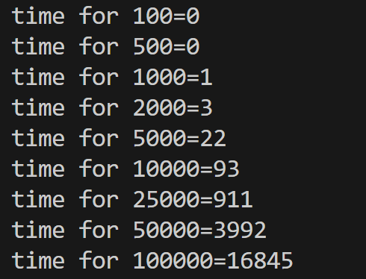
Bubble Sort
Worst Case : O(n^2)
Best Case : O(n^2)

Slide 4
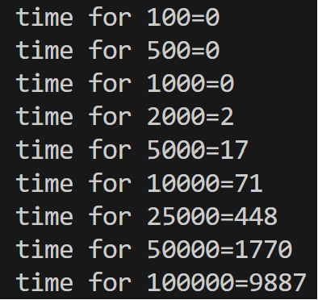
Insetion Sort
Best Case : O(n)
Worst Case : O(n^2)

Slide 5
Selection Sort
Best Case : O(n^2)
Worst Case : O(n^2)

Slide 6
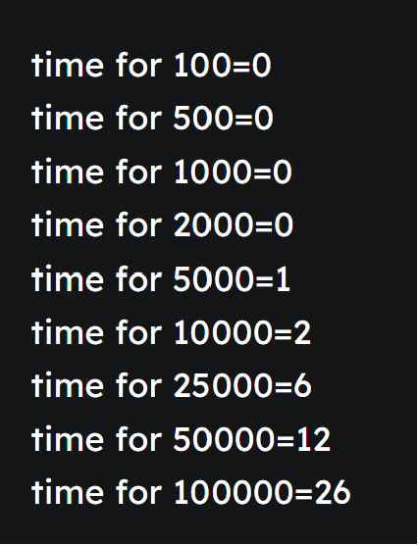
Quick Sort
Best Case : O(n* Log(n))
Worst Case : O(n^2)

Slide 7
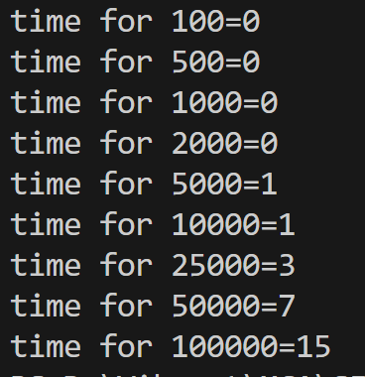
Merge Sort
Best Case : O(n*Log(n))
Worst Case : O(n*Log(n))

Slide 8
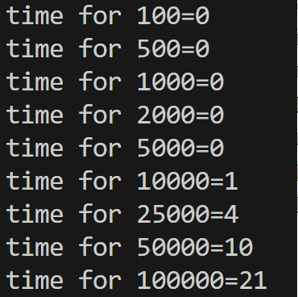
Heap Sort
Best Case : O(n*Log(n))
Worst Case : O(n*Log(n))

Slide 9
INPUT SIZE VS TIME(in milliseconds)
 | 100 | 500 | 1000 | 2000 | 5000 | 10000 | 25000 | 50000 | 100000
Bubble Sort | 0 | 0 | 1 | 3 | 22 | 93 | 911 | 3992 | 16845
Insertion | 0 | 0 | 0 | 2 | 17 | 71 | 448 | 1770 | 9887
Selection | 0 | 0 | 0 | 1 | 10 | 41 | 245 | 970 | 3875
Quick Sort | 0 | 0 | 0 | 0 | 1 | 2 | 6 | 12 | 26
Merge Sort | 0 | 0 | 0 | 0 | 1 | 1 | 3 | 7 | 15
Heap Sort | 0 | 0 | 0 | 0 | 0 | 1 | 4 | 10 | 21

